Slide 1
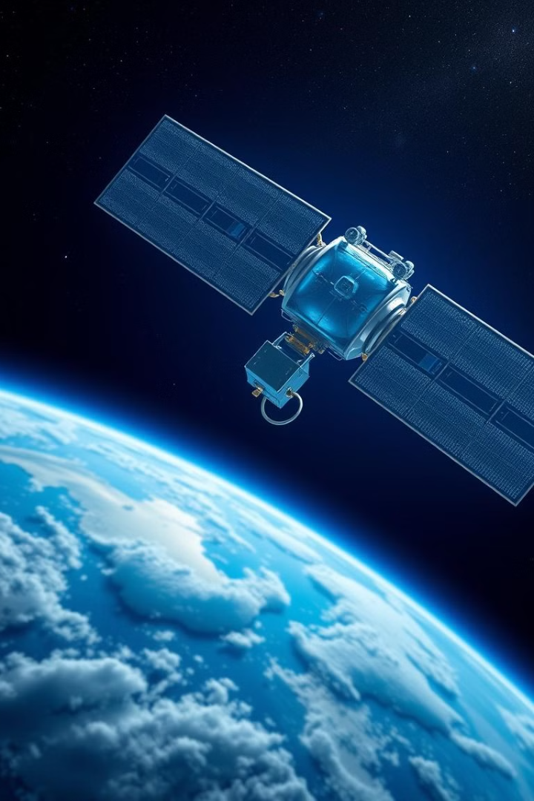
PACE: Advancing Ocean and Atmospheric Science
The PACE (Plankton, Aerosol, Cloud, ocean Ecosystem) mission is a NASA Earth-observing satellite dedicated to studying the ocean and atmosphere.

Slide 2
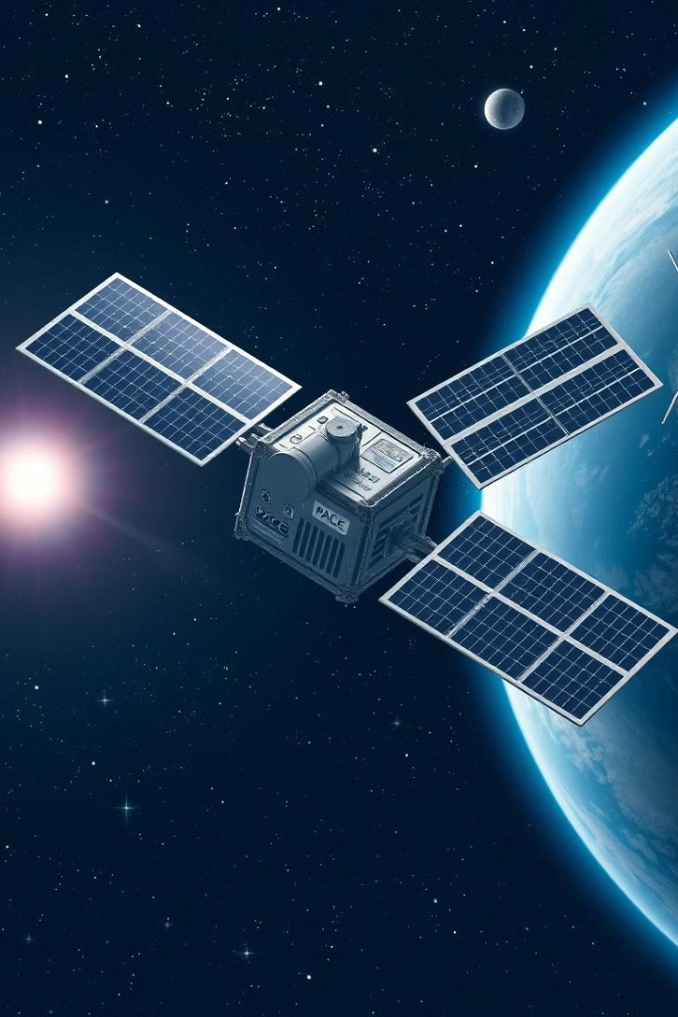
Overview of the PACE Mission
1
Launch
The PACE satellite was launched in 2024, marking a significant milestone in Earth observation.
2
Orbit
PACE orbits Earth, collecting data from a range of instruments designed to measure ocean color, aerosols, and clouds.
3
Data Transmission
Collected data is transmitted to Earth, where it is processed and made available to the scientific community.

Slide 3

Key Scientific Objectives of PACE
1
Ocean Color
2
Aerosols
PACE measures ocean color to study phytoplankton, the foundation of the marine food web, and its role in the global carbon cycle.
PACE analyzes aerosols, tiny particles in the atmosphere, to understand their impact on climate, air quality, and human health.
3
Clouds
4
Ecosystems
PACE observes clouds to study their properties and impact on Earth's energy balance and precipitation patterns.
PACE studies the interaction between the ocean, atmosphere, and biosphere to understand how these systems function and respond to change.

Slide 4
Instruments and Sensors on Board PACE
Ocean Color Imager (OCI)
Multi-Angle Polarimetric Sensor (MAPS)
Spectro-Polarimeter for Planetary Exploration (SPEXone)
Measures ocean color in multiple spectral bands to study phytoplankton, water clarity, and marine ecosystems.
Measures the polarization of light to study aerosols, clouds, and their impact on climate.
Measures the polarization and spectral properties of light to study atmospheric composition and clouds.

Slide 5
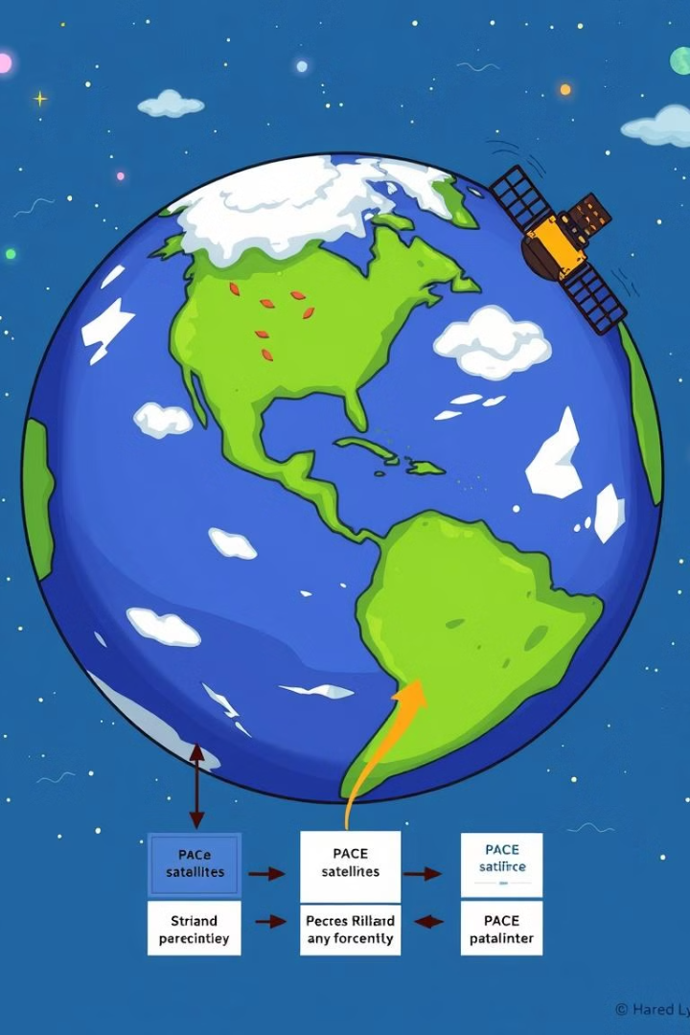



Data Collection and Processing
Data Acquisition
PACE instruments collect data continuously as the satellite orbits Earth.
Data Transmission
Collected data is transmitted to ground stations for processing and analysis.
Data Processing
Raw data is calibrated, corrected for instrument errors, and converted into usable formats.

Slide 6
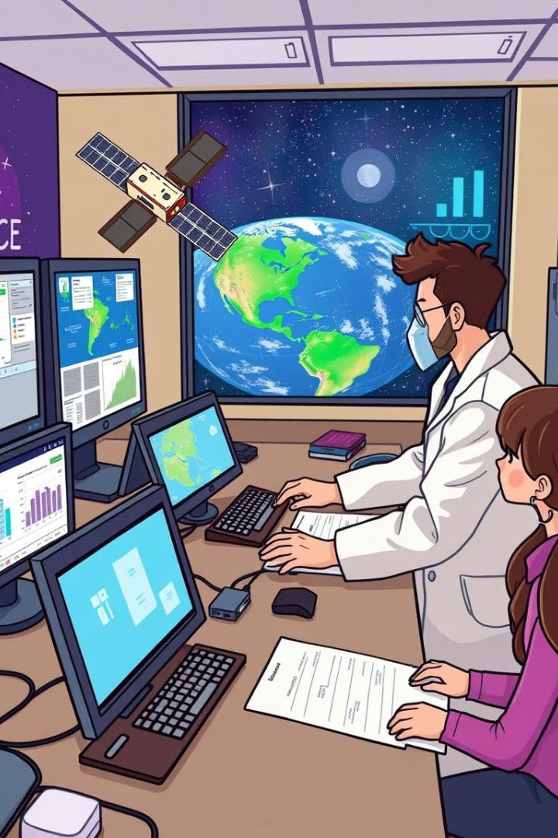
Analyzing PACE Data for Ocean and Atmospheric Studies
Ocean Color
Phytoplankton abundance, distribution, and diversity
Water clarity, nutrient levels, and primary productivity
Aerosols
Aerosol type, size, and distribution
Impact on climate, air quality, and human health
Clouds
Cloud properties, including altitude, thickness, and composition
Influence on Earth's energy balance and precipitation patterns

Slide 7




Sharing PACE Data with the Scientific Community
Data Archives
Scientific Publications
Public Outreach
Processed PACE data is made available through online data archives for researchers worldwide.
Scientists use PACE data to publish research findings in peer-reviewed journals.
PACE data is used to educate the public about the importance of ocean and atmospheric science.

Slide 8
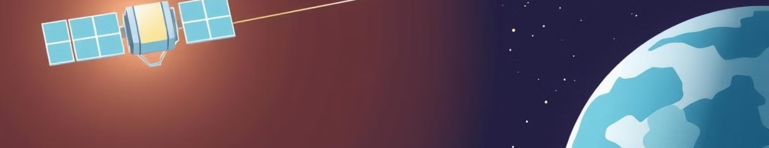
Conclusion and Future Plans for PACE
Data Collection
Scientific Research
Future Missions
PACE continues to collect data to study long-term changes in the ocean and atmosphere.
PACE data is used to advance our understanding of climate change, ocean health, and the Earth system.
PACE lays the groundwork for future Earth-observing missions that will continue to provide valuable insights into our planet.

